Slide 1

Capstone Project
AIR TRANSPORT SYSTEM

Slide 2



Personal BACKGROUND
(Name, Past Experience, Qualification, Career Summary)
Name : Banu Priya Selvaraj
Past Experience :
AR & VR Developer, iQube (Sep 2021 - May 2024) Developed game design layouts, levels, and characters using the latest software in an innovative student research center.
Qualification : B.E -ECE
Career Summary :
Tech enthusiast with expertise in AR/VR development and content creation.
Contributed to innovative projects, combining technical skills in immersive technologies and data analytics with creative content design.
www.collaberadigital.com

Slide 3


Key Takeaways/Learnings from the Program (HTD)
Java Mastery: Advanced skills in Core and Advanced Java, including OOP, collections, and exception handling.
Database Proficiency: Expertise in SQL and relational database management.
Spring Boot & Microservices: Built scalable microservices using Spring Boot, Spring Cloud.
Agile Methodologies: Applied Scrum practices using Jira.
Testing & QA: Utilized JUnit and SonarQube for robust testing and code quality.
AWS Cloud Basics: Gained foundational knowledge of AWS services.
Intro to Generative AI: Explored basics of AI models and applications

Slide 4

Problem Statement of the Capstone Project
Develop an Air Transport System (ATS) to manage various bookings, airport details, and plane details.
Challenges Addressed by the ATS Project :
Inefficient Booking Management: Airlines and airports face challenges in managing and updating bookings efficiently, leading to operational delays.
Complex Data Handling: Handling the details of multiple airports and planes across the globe is complex, requiring robust data management solutions.
Security and Compliance: Ensuring secure access and compliance with aviation regulations poses significant challenges, particularly in a decentralized environment.

Slide 5
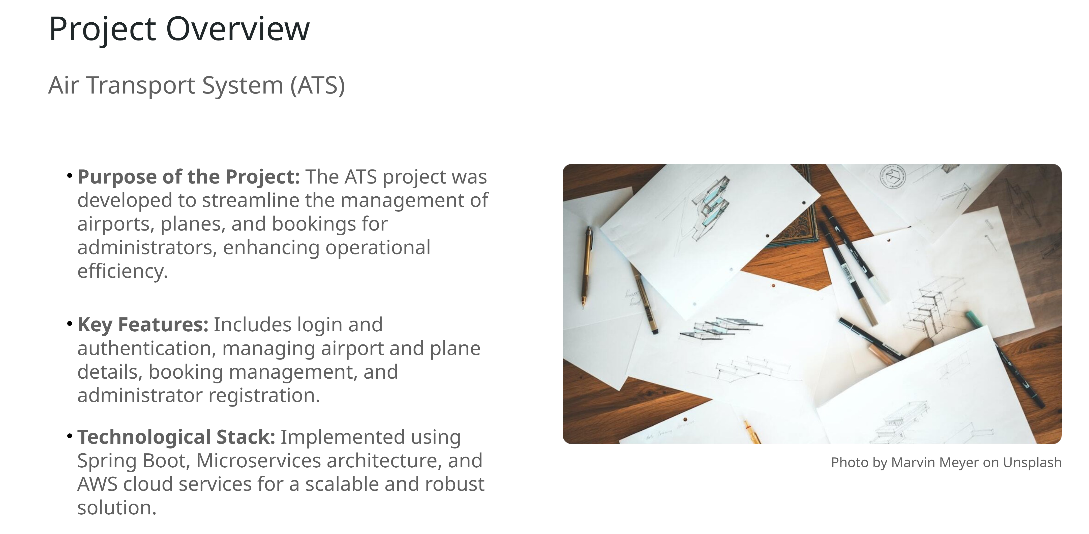
Develop an Air Transport System (ATS) to manage various bookings, airport details, and plane details.

Slide 6
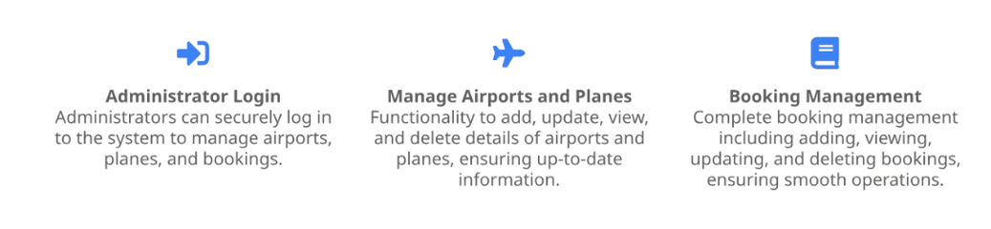
USER STORIES AND FUNCTIONAL REQUIREMENTS

Slide 7
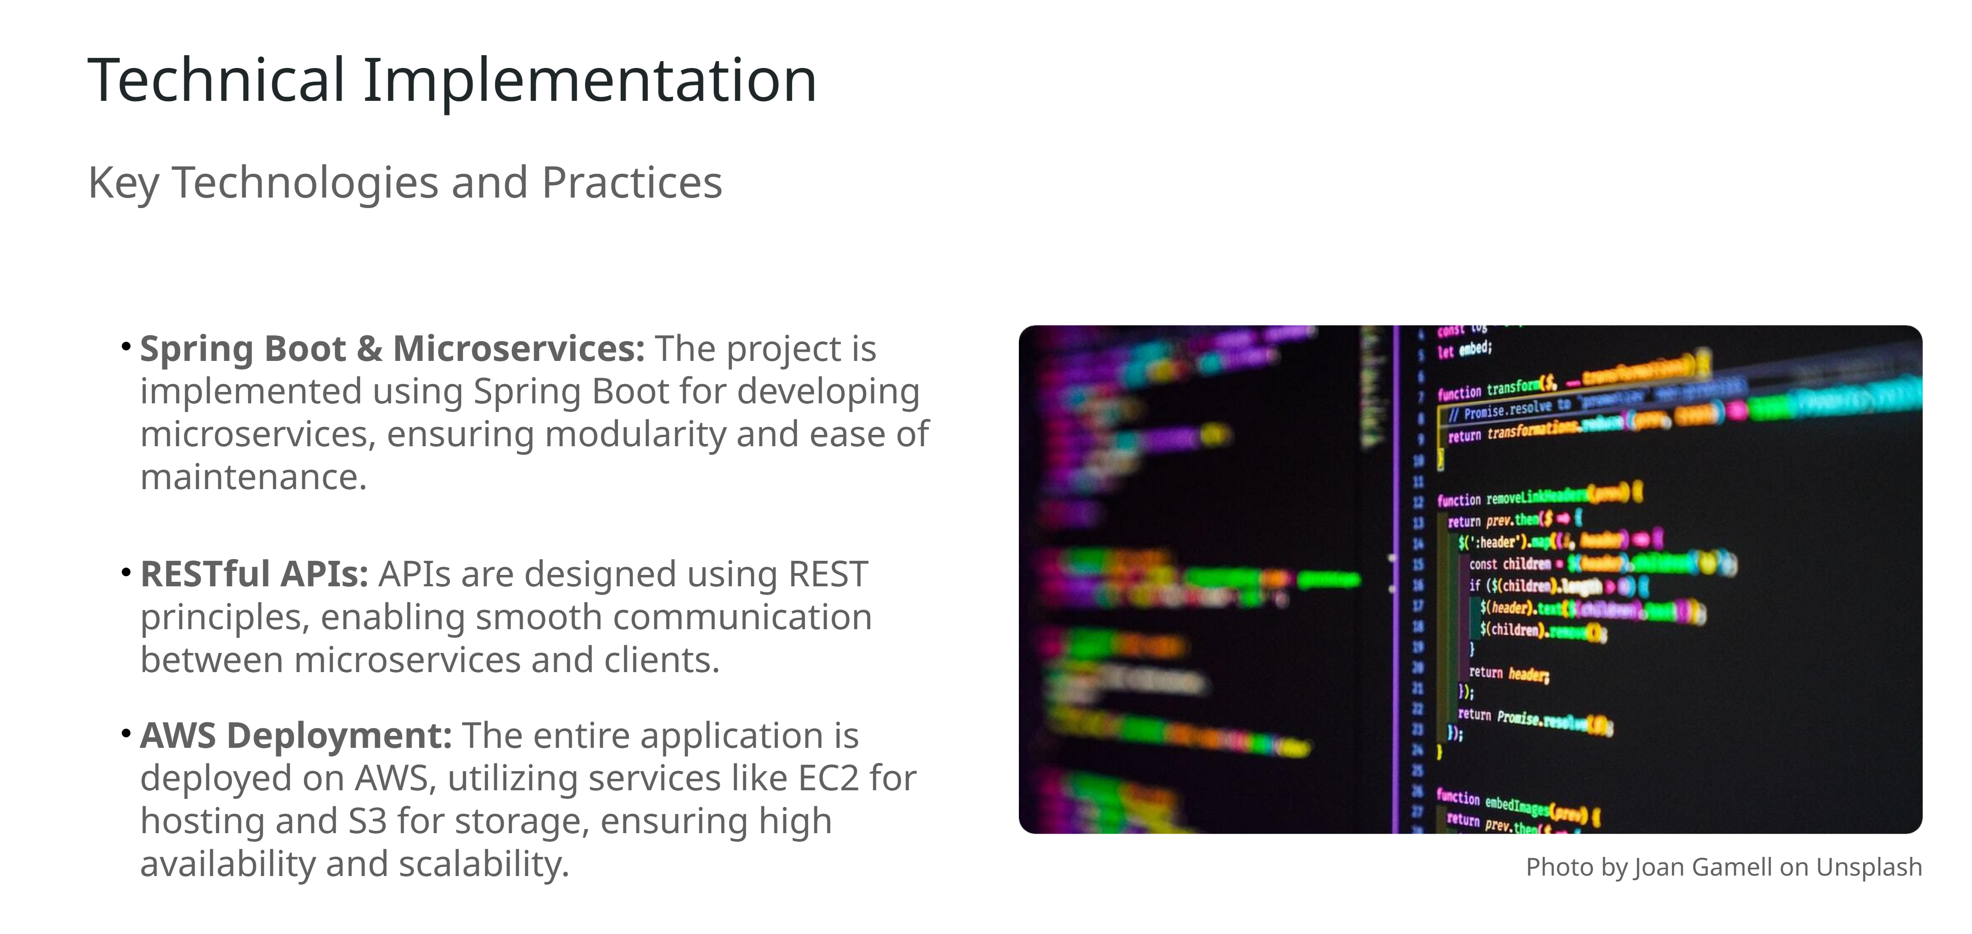

Slide 8
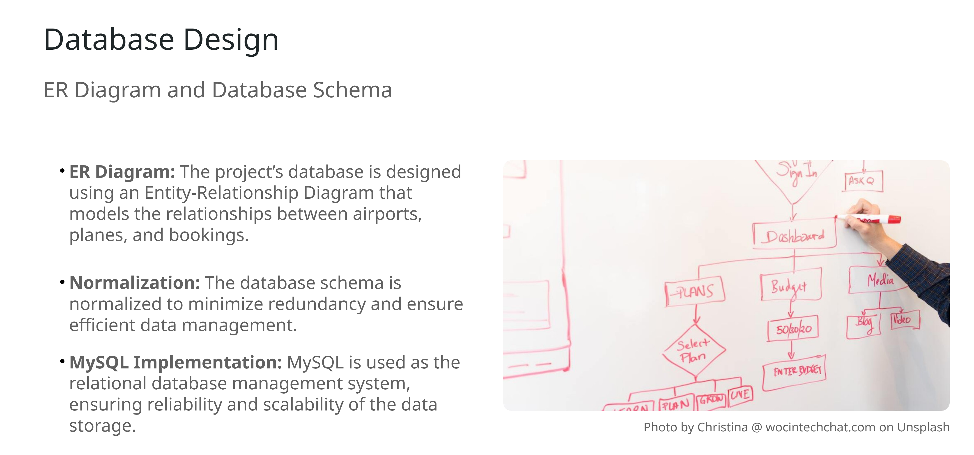

Slide 9
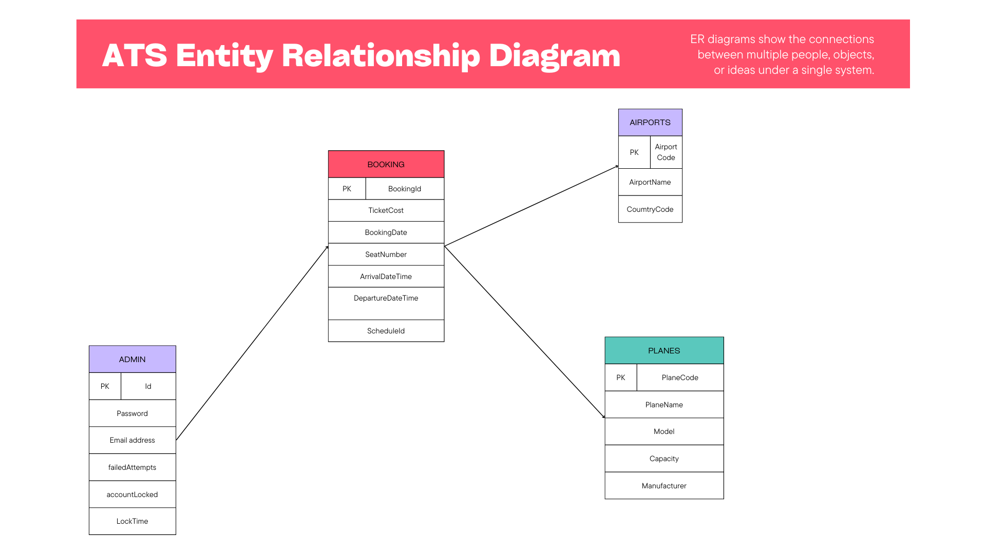
Key Takeaways/Learnings from the Program (HTD)

Slide 10
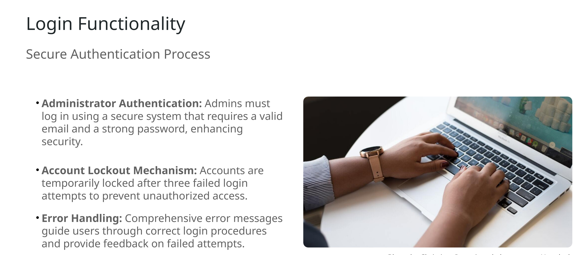

Slide 11
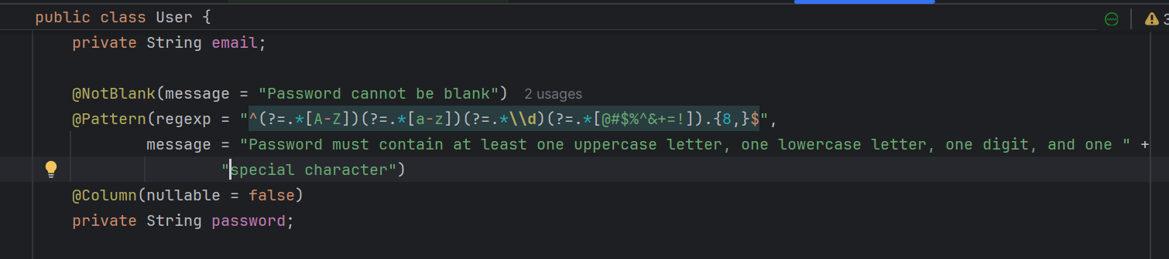
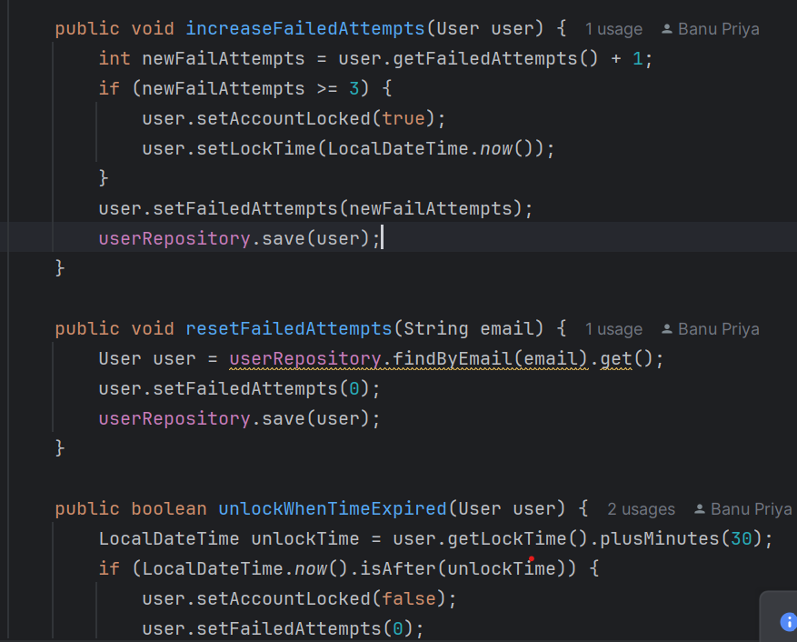
Important areas of the Project with screenshots

Slide 12
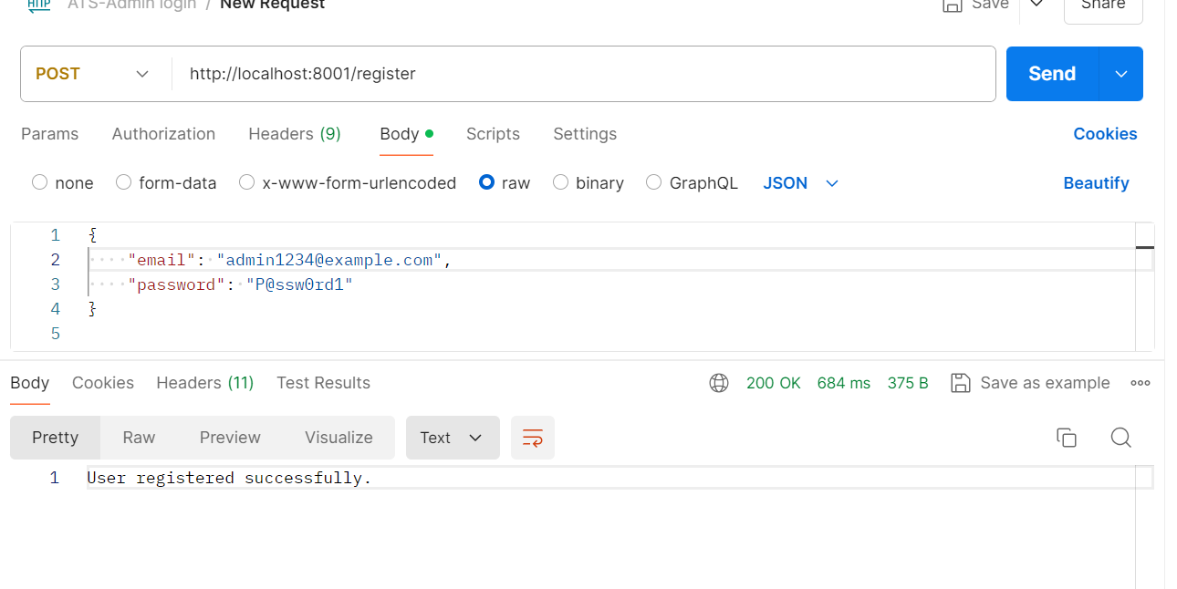
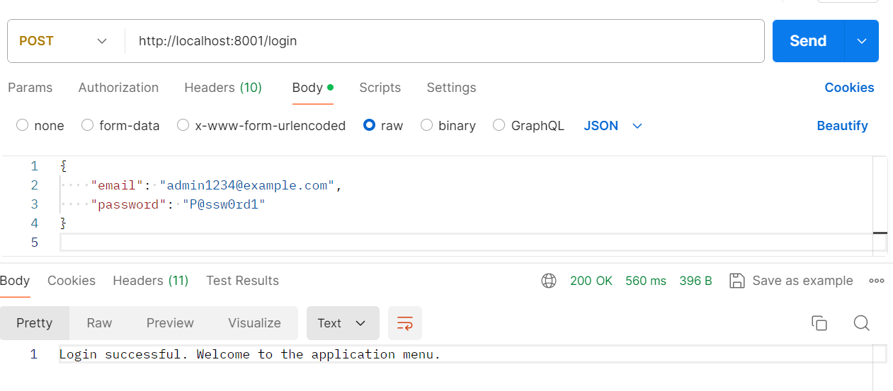
Important areas of the Project with screenshots

Slide 13
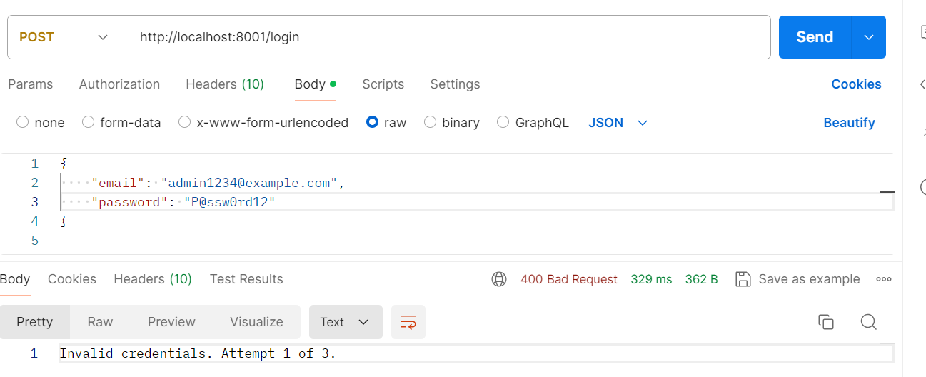
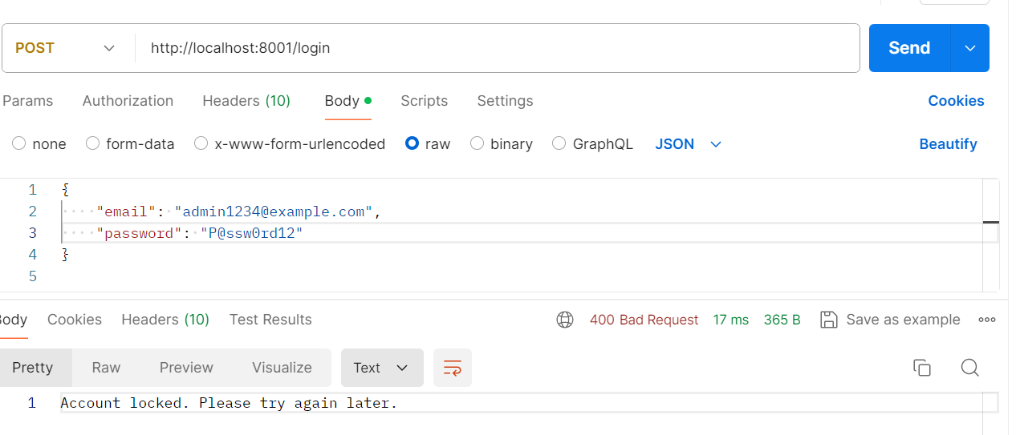
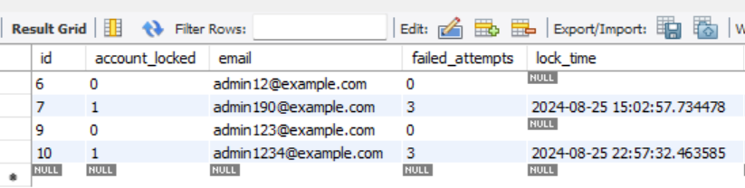
Important areas of the Project with screenshots

Slide 14
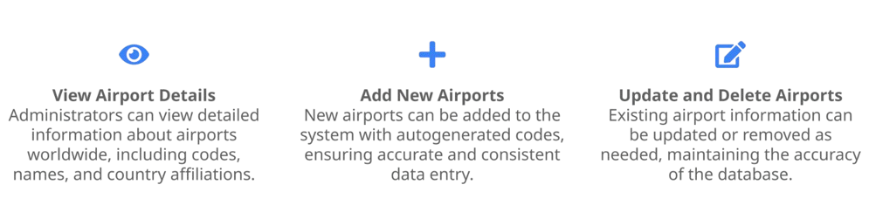
AIRPORTS MANAGEMENT

Slide 15
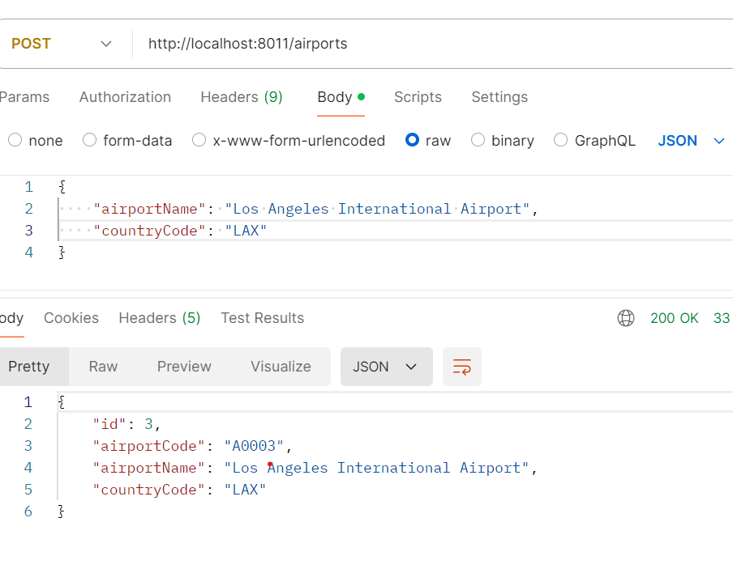
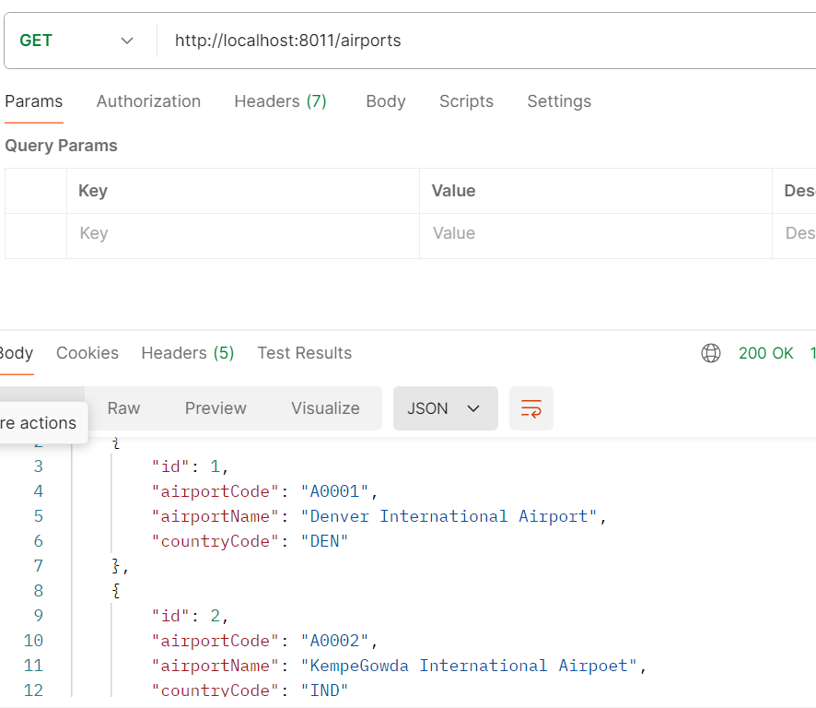
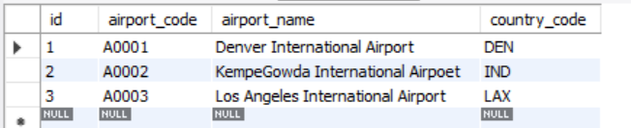
Important areas of the Project with screenshots

Slide 16
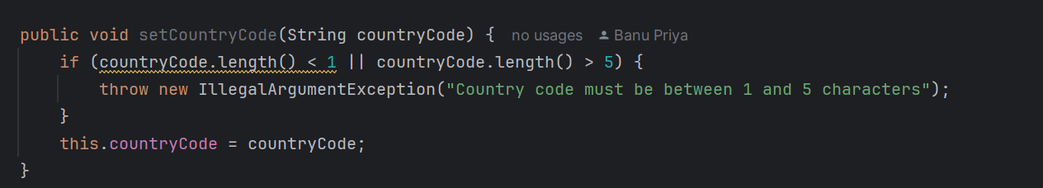
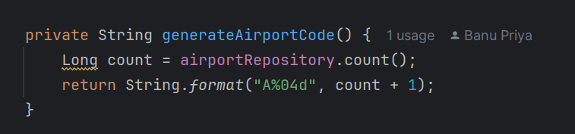
Important areas of the Project with screenshots

Slide 17


Planes Management
Managing Aircraft Details
View Plane Information: Administrators can access detailed information about planes, including registration numbers, models, and seating capacities.
Add New Planes: The system allows for the addition of new planes with autogenerated numbers, ensuring data consistency.
Update and Delete Planes: Existing plane details can be modified or removed, enabling accurate and current data maintenance.
This Photo by Unknown Author is licensed under CC BY-SA

Slide 18
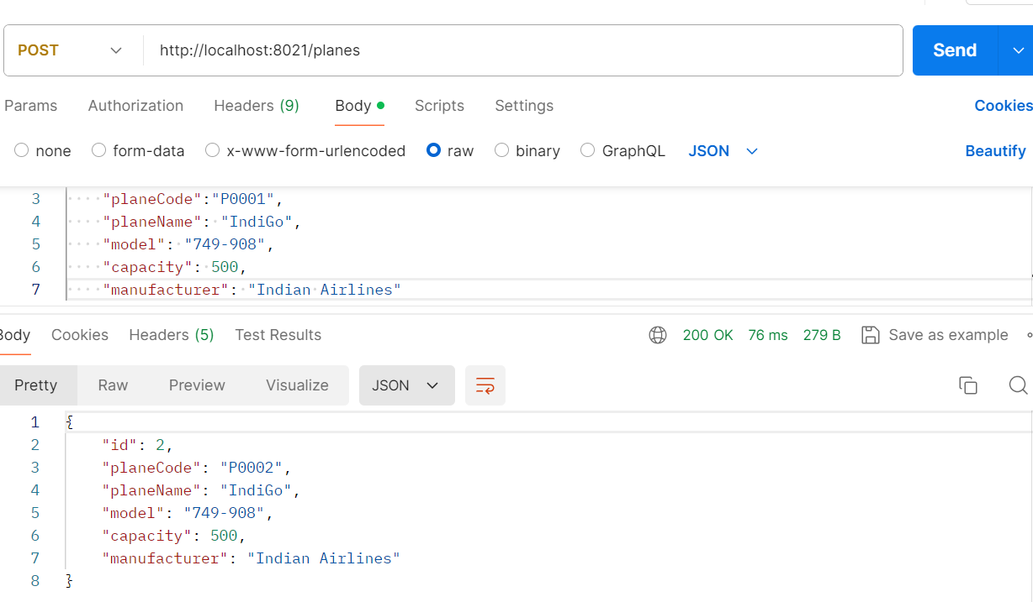
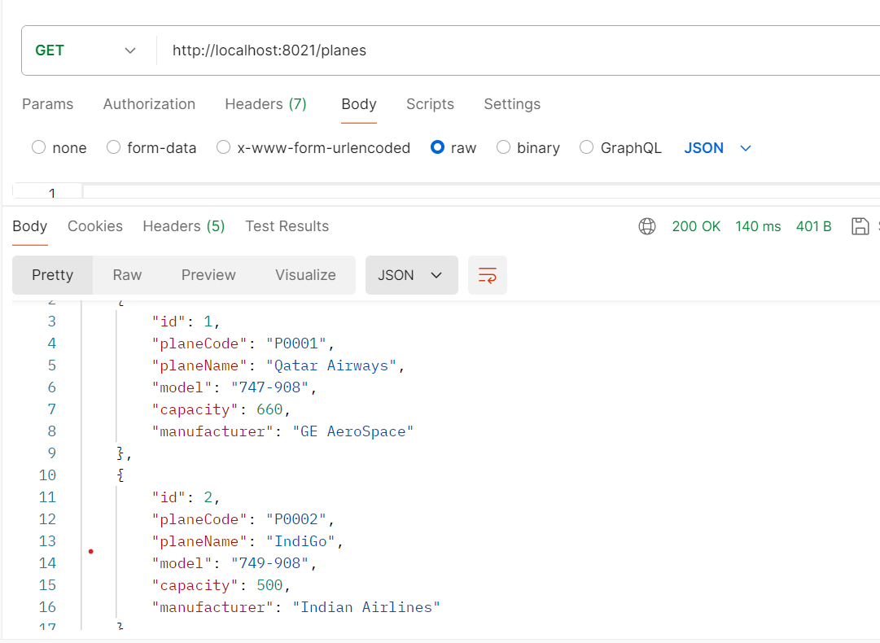
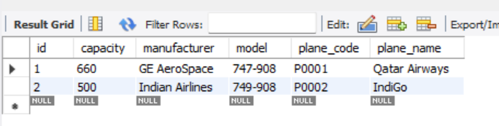
Important areas of the Project with screenshots

Slide 19
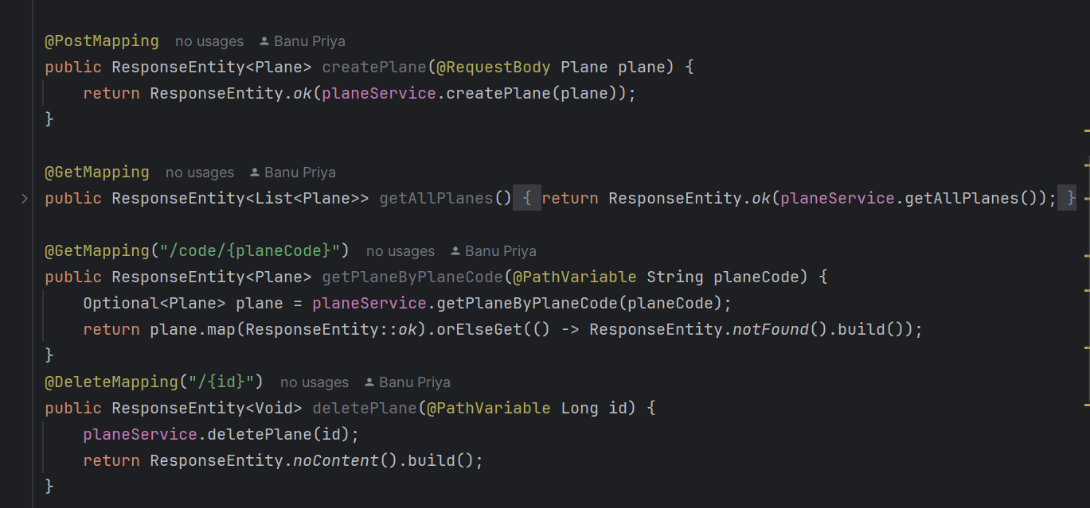
Important areas of the Project with screenshots

Slide 20
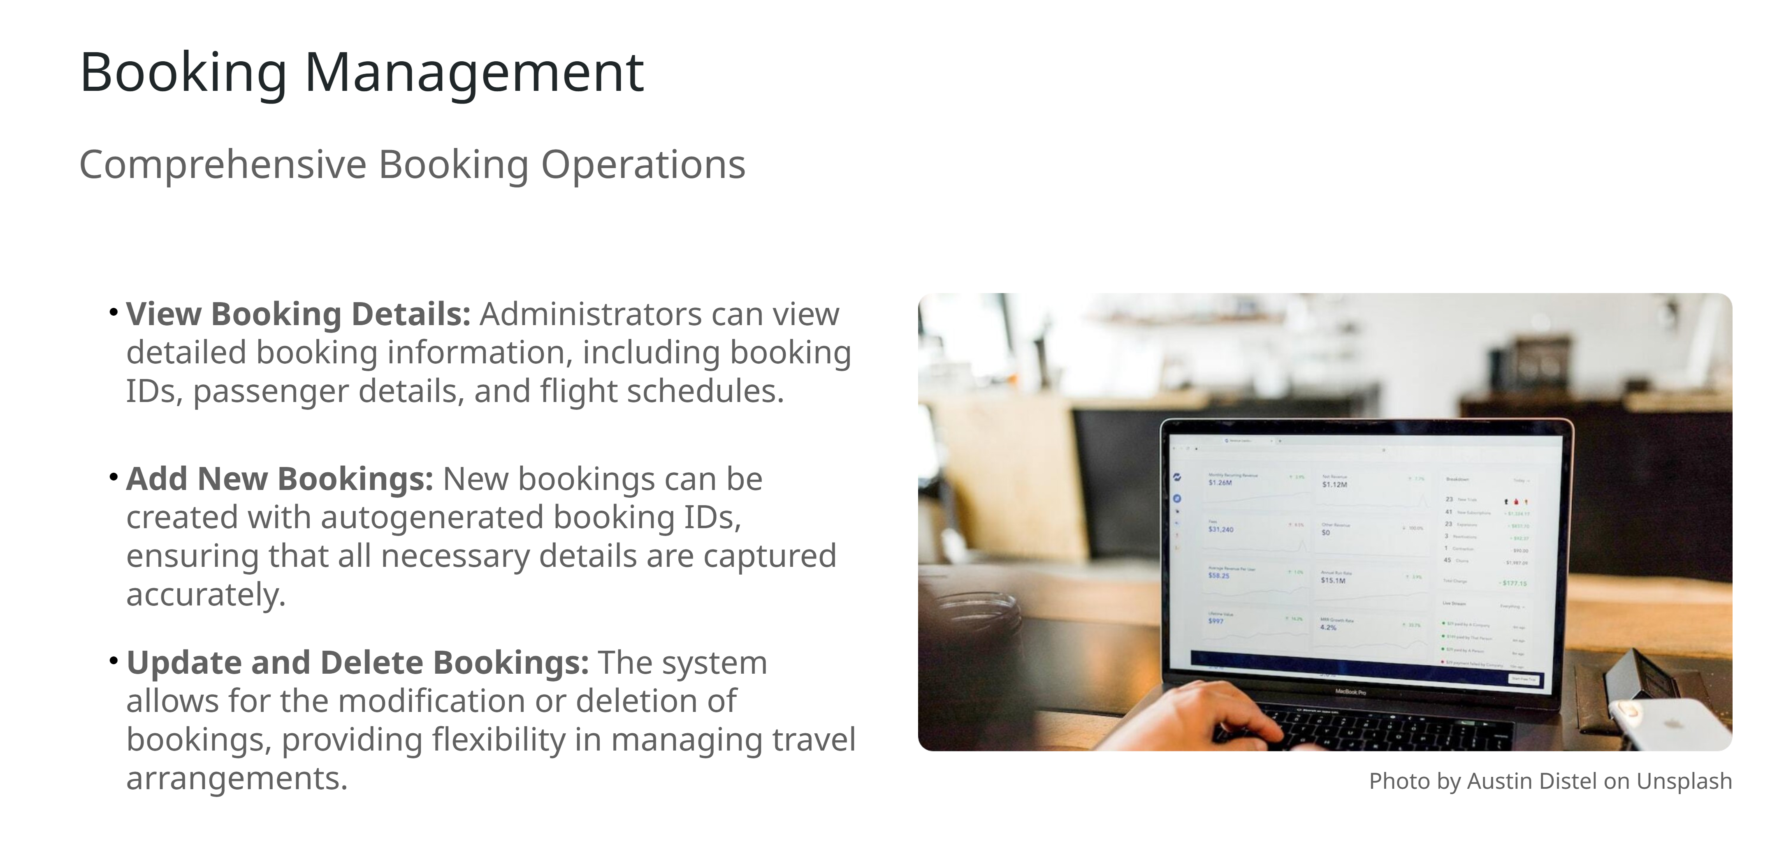

Slide 21
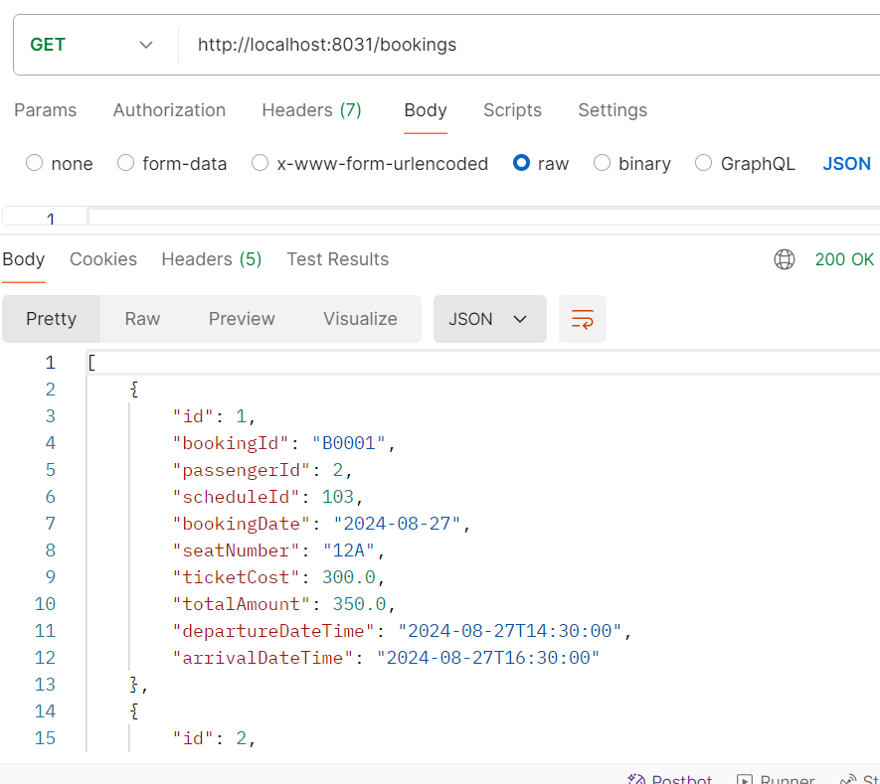
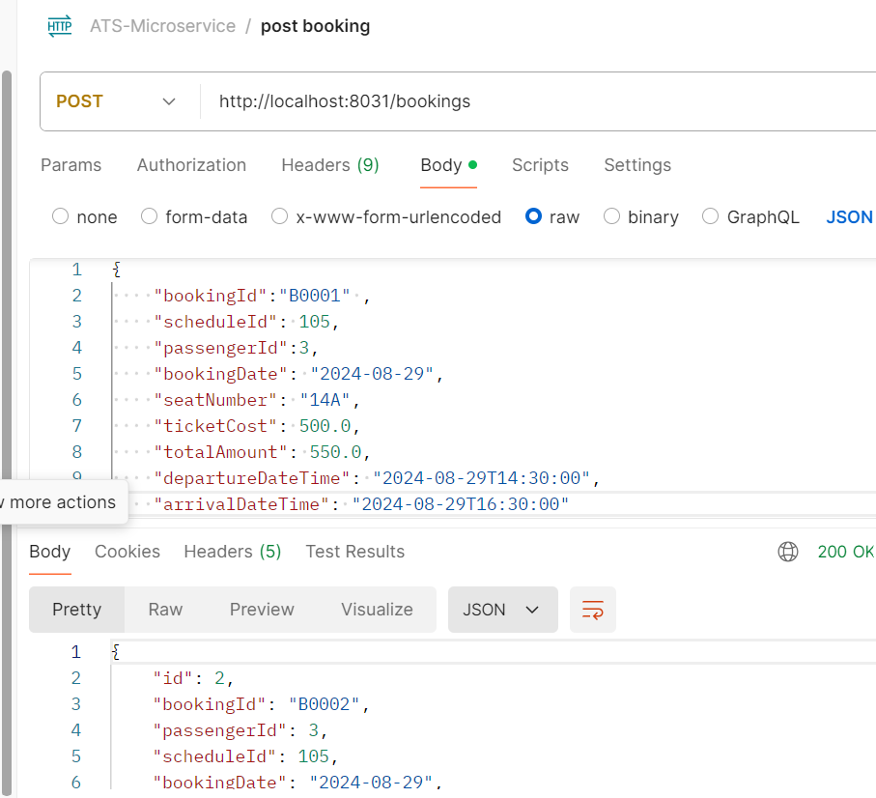
Important areas of the Project with screenshots

Slide 22
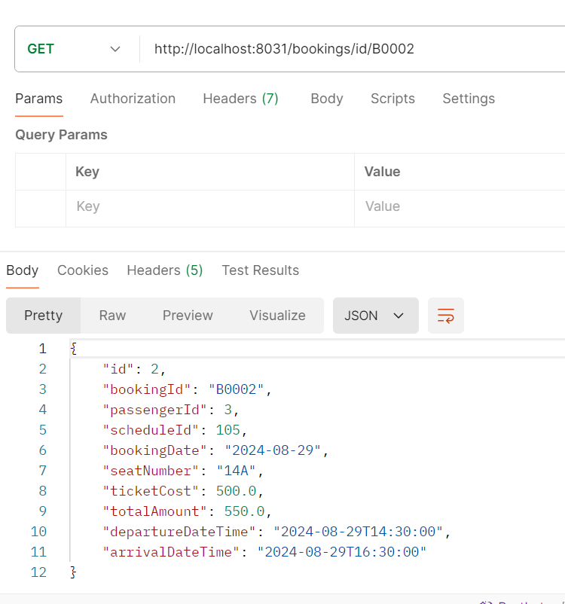
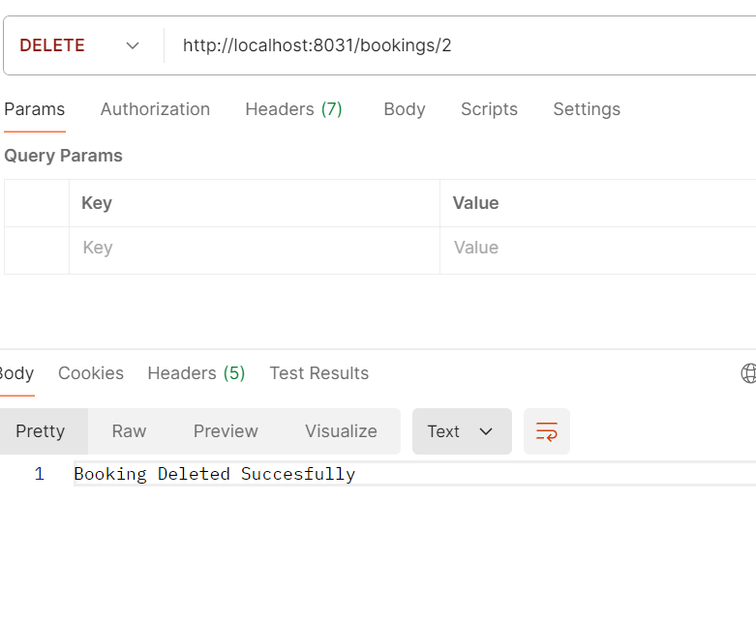
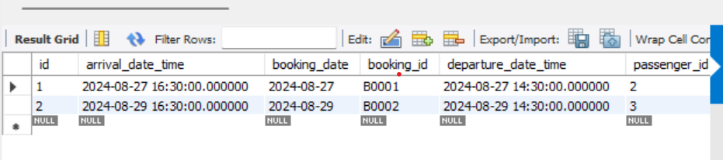
Important areas of the Project with screenshots

Slide 23
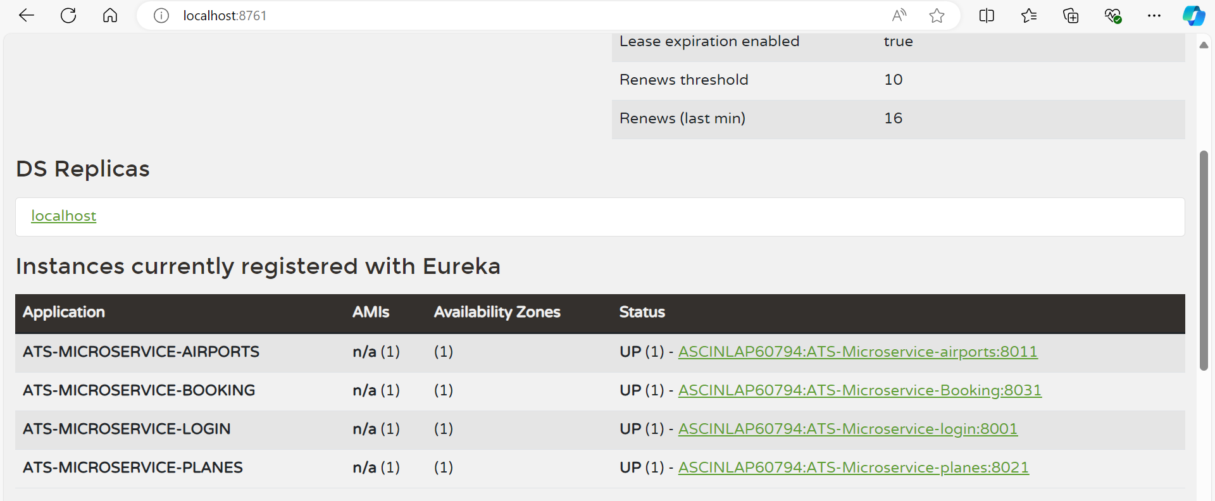
Instances registered with eureka

Slide 24
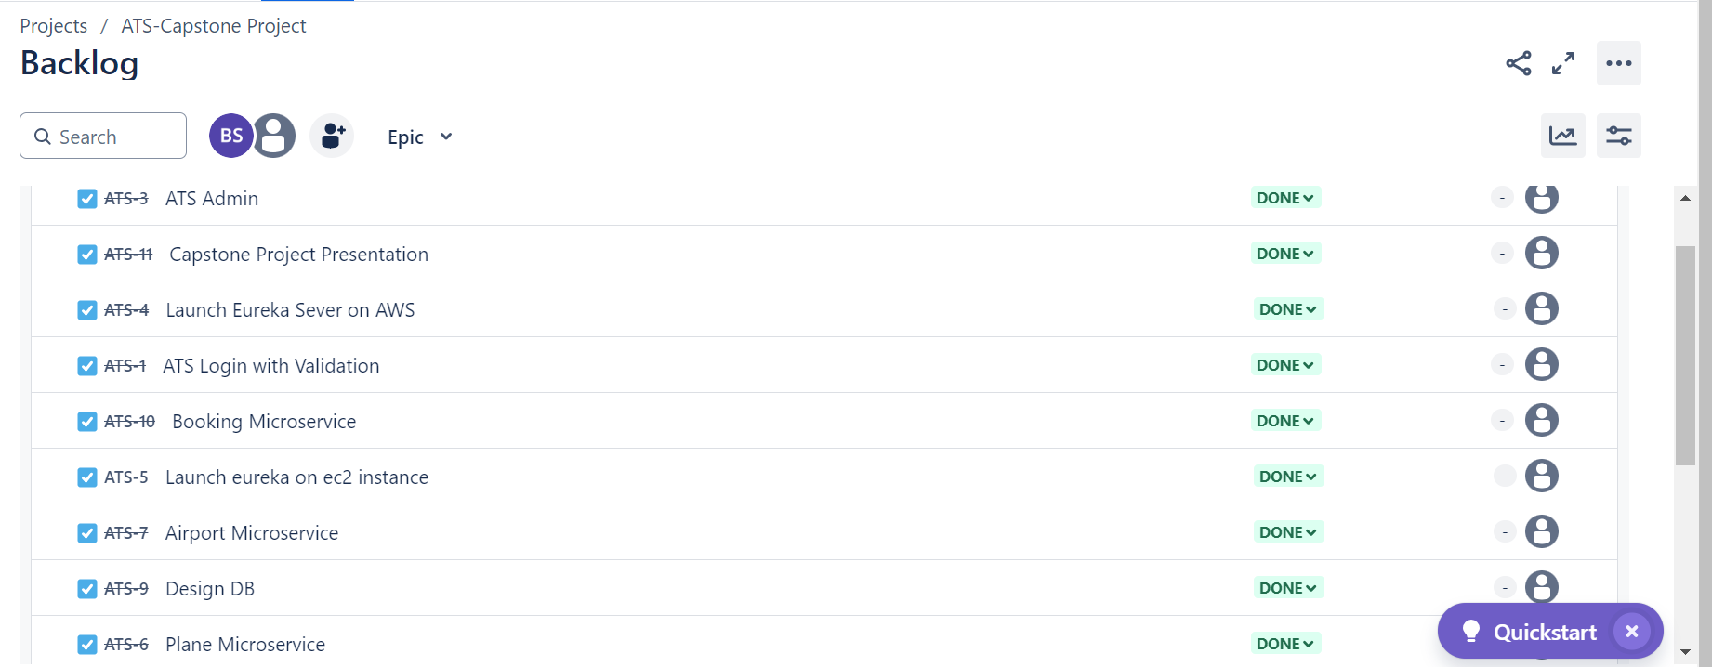
ATS-Capstone Project –JIRA DASHBOARD
Conclusion
Summary: Successfully implemented an Air Transport System with a focus on modularity, security, and scalability using Spring Boot Microservices.
Challenges: Overcame challenges in deploying microservices on AWS and managing service communication.
Future Enhancements: Considerations for scaling the system, integrating more robust scurity measures, and enhancing the user interface.

Slide 25
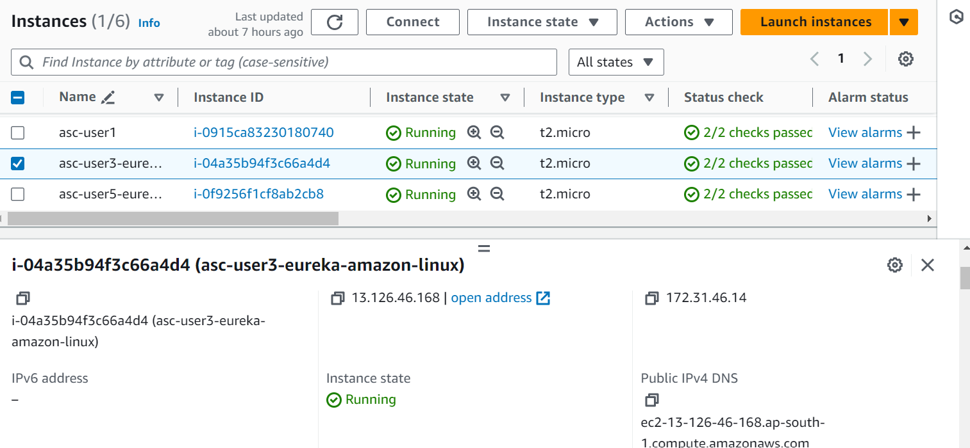
Instance Deployed in AWS
Conclusion
Summary: Successfully implemented an Air Transport System with a focus on modularity, security, and scalability using Spring Boot Microservices.
Challenges: Overcame challenges in deploying microservices on AWS and managing service communication.
Future Enhancements: Considerations for scaling the system, integrating more robust scurity measures, and enhancing the user interface.

Slide 26
Conclusion
Summary: Successfully implemented an Air Transport System with a focus on modularity, security, and scalability using Spring Boot Microservices.
Challenges: Overcame challenges in deploying microservices on AWS and managing service communication.
Future Enhancements: Considerations for scaling the system, integrating more robust security measures, and enhancing the user interface.

Slide 27
Thank You

